Slide 1
Transformer and BERT
Date: 11.11.2022

Slide 2
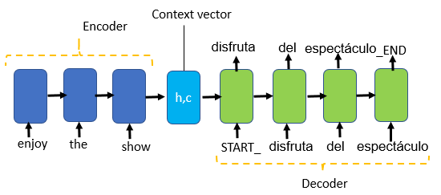
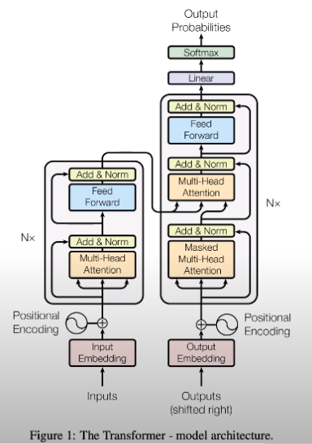
RNN vs Transformer
RNN:
Sequence to sequence processing
No parallel computation
Difficult to process longer input sequence. LSTM and GRU solve this problem to some extent
Slow processing
Transformer:
No Sequence to sequence processing
parallel computation
No dependency between the time steps
Faster processing

Slide 3
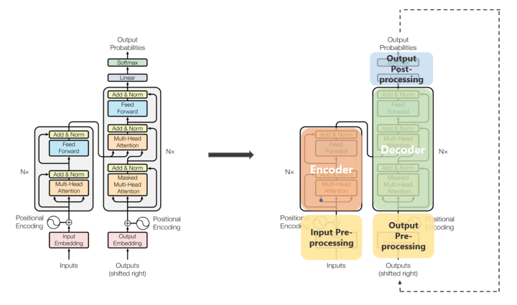
Transformer components

Slide 4
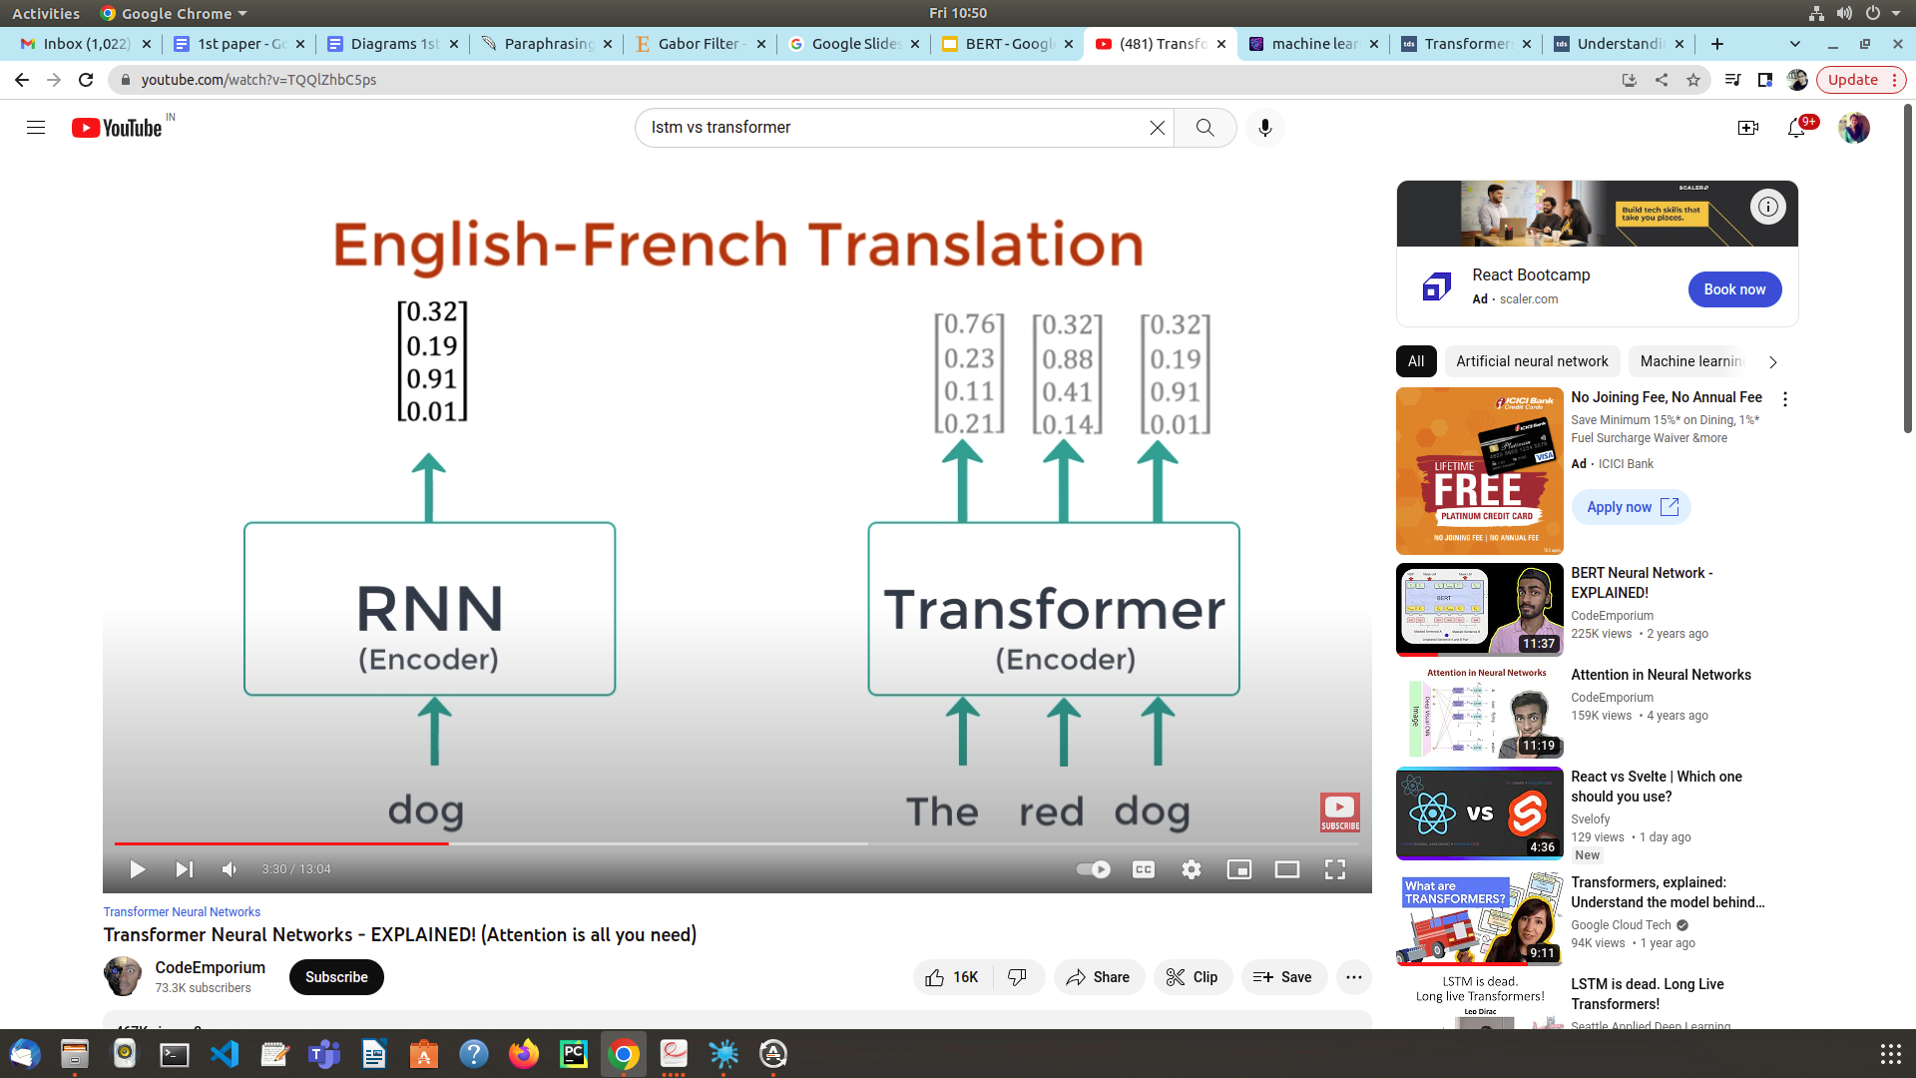
Need of attention in transformer: preserve the semantics in the input as well as in the output sequence.
English => French
red => rouge
dress => robe
“red dress” => “robe rouge”
Notice how red is before dress in English but rouge is after robe.

Slide 5
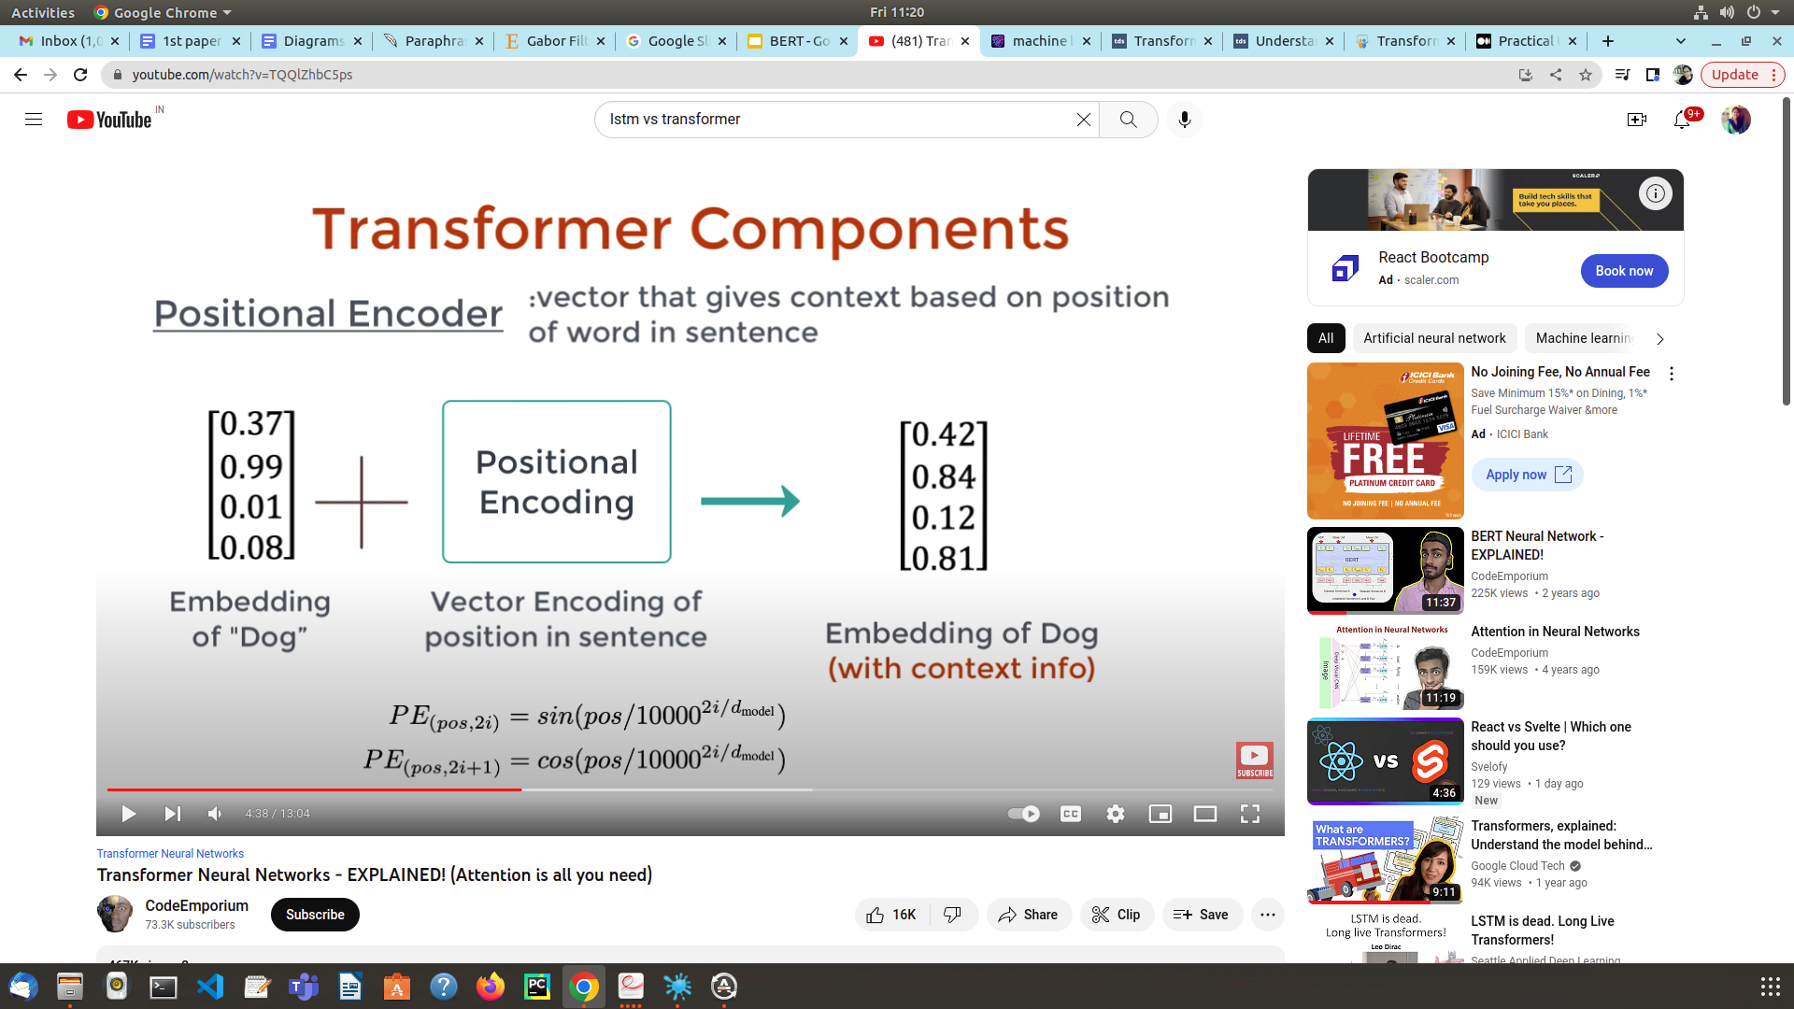
Positional encoder: vector that give context based on position of word in a sentence.
Bob’s dog looks Cute. —--Position 2
Bob looks like a dog. —----position 5

Slide 6
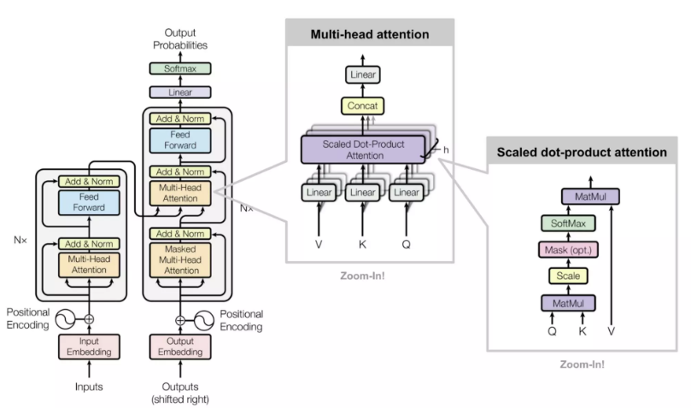
Multi-head attention working

Slide 7
Transfer learning
Step1: Pre-train a model
Step 2: Fine tune for the specific task(be it image or language task)
Transfer learning became the default strategy for computer vision tasks from the year 2014.People often use models that are pre-trained for image classification on imagenet.

Slide 8
Transfer learning in Natural language processing
Transfer learning is a powerful tool for natural language processing also. .
Tools using transfer learning in the backend;
BERT
GPT
ELMo
BERT stands for Bidirectional Encoder Representations from Transformers.
It requires least fine tuning also. It is self-supervised model.

Slide 9

After fine-tuning BERT can handle a range of tasks, including:
Sentiment Analysis:
But believe me or not,it is one of the most beautiful and evocative work i have seen. [very positive]
Identify relevant Documents:

Slide 10
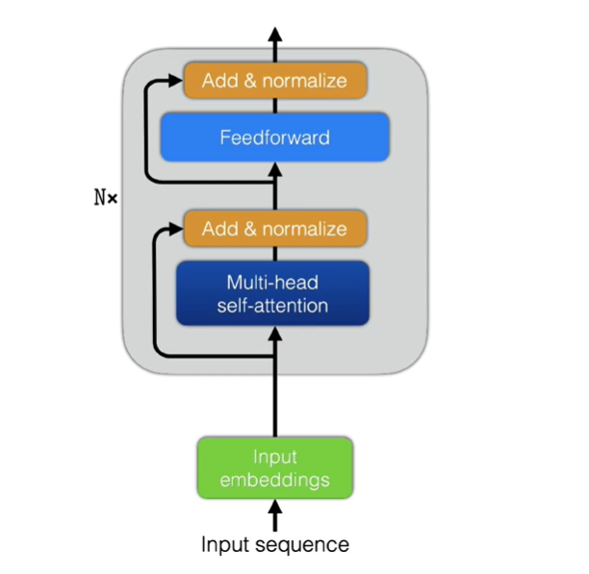
BERT Architecture
BERT is based on transformer Encoder.
Two versions:
-BERT-BASE: N=12, d=768, h=12, #parameters=110M
-BERT-LARGE: N=24, d=1024, h=16, #parameters=340M
N= encoder blocks , d= vector embedding,h= multi head self-attention unit

Slide 11
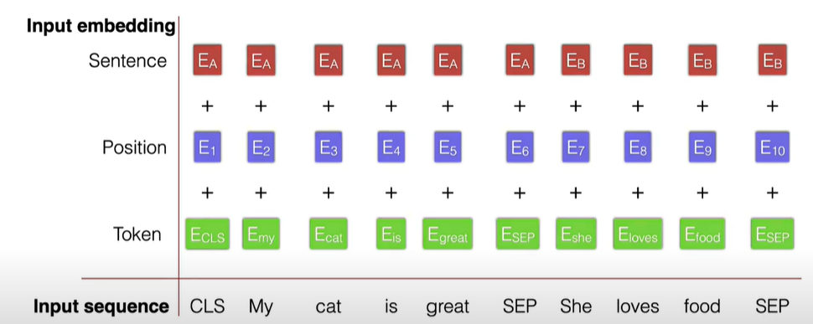
Input Representation

Slide 12
During training, the input contains two input sequences/sentences Sentence A Sentence B.
Sentences are separated by SEP token. SEP determines the start and end of a sentence.
Input sequence always start with classification token CLS. CLS works as a tool to identify a classification task.
For all the other tokens of the input we will try to compute more informative embeddings of that token where the context is taken into account
For the CLS token the objective is to obtain an embedding that summarizes the entire sequence such that we can use it to perform classification on the sequence.
Input embeddings are sum of token,position and sentence embeddings.

Slide 13
Token embedding describe the word itself.
Position embedding describe where the word located in the sequence.
Sentence embedding describes to which sentence the sequence or word belongs to.
input embedding : Token embedding + Position embedding +sentence embedding
Ex: input embedding for ‘great’ : Egreat+E5+EA
‘Food’ : Efood+E9+EB

Slide 14
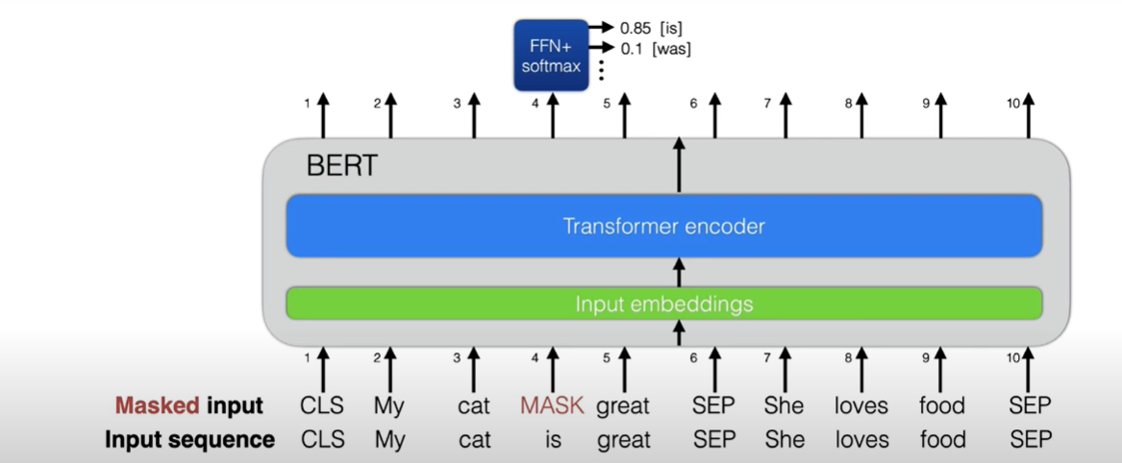
BERT Pre-training
BERT has two pre-training tasks.
1st Task: Masked word prediction
-15% of words are masked.
-predict masked word

Slide 15
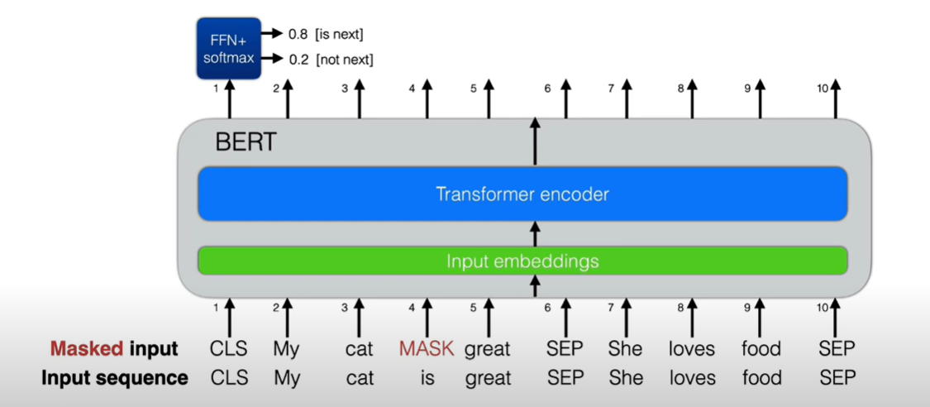
2nd task:
Select Sentence B as the sentence after A with 50% probability.
Use CLS output classify B as next/other sentence.

Slide 16
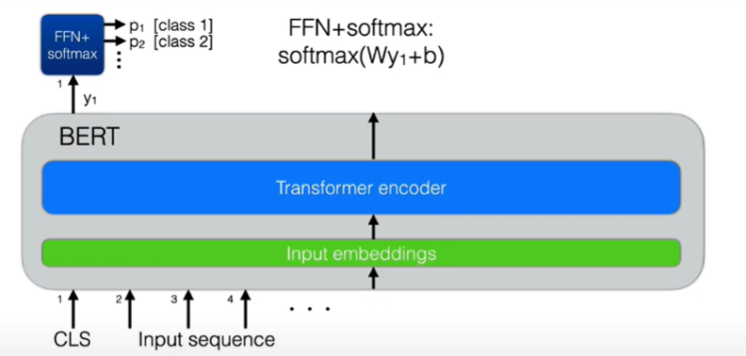
Fine-tuning BERT
Collect Annotated dataset.
For sequence level classification tasks:
Use output from CLS token for classification.
Add single layer FFN(feed forward network)
Fine-tune end to end by applying cross entropy loss.

